Slide 1
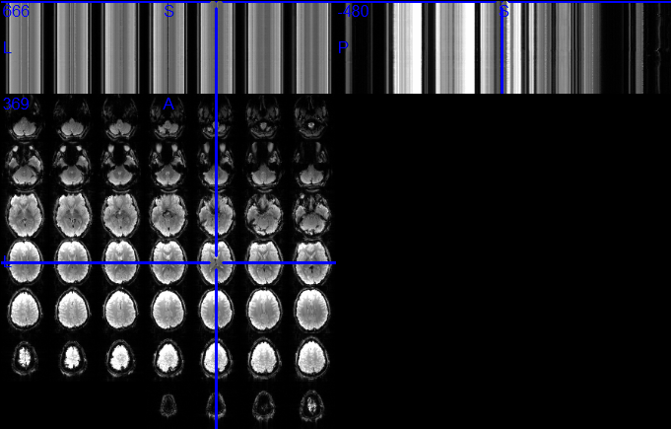
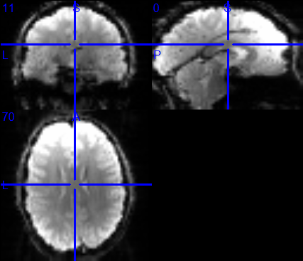
Figure #. The comparison between conversion functions from oro.dicom package (A) and from our Brainbase package (B). Our function showed better compatability with widely-used visualization tools (e.g., MRIcron).

Slide 2

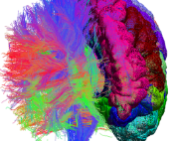
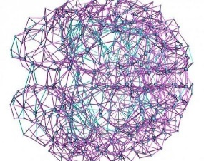
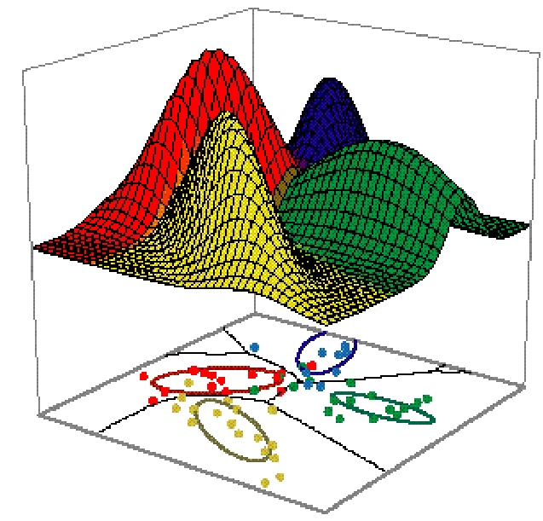
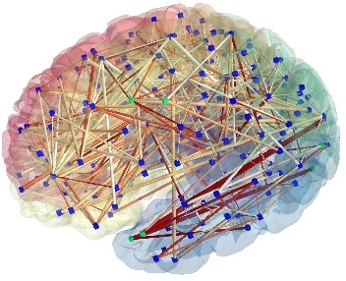
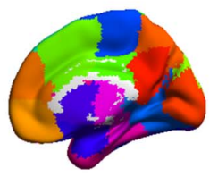
Neuroscientists
Experimental design and Multi-modal data acquisition
Data processing and analysis
High-quality and easy-access datasets
Statisticians
Modeling high-dimensional and large-scale imaging data
Statistical and informatic methods for extracting critical informations and nuisance regression.
Inter-disciplinary communication hub
New statistical methods with user-friendly toolboxes
Promising Applications
Theoretical and clinical research
The connectivity pattern of complex brain networks,
Functional module detection and navigation
Biomarker identification and mechanism study for different diseases and psychological or behavioral process
…
Figure #. Schematic of the inter-disciplinary collaboration framework of Brainconductor project.

Slide 3
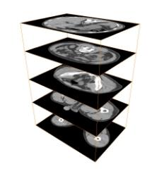
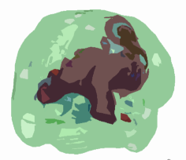
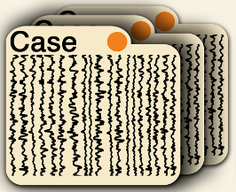
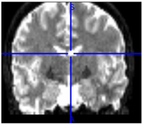
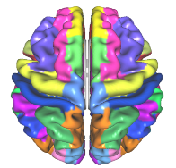
Raw data acquisition
I/O & Data preprocessing
Processing
& analysis
Dicom headers (Metadata)
Population phenotype
 | Subjects
keys
Key words
Labels
Descriptions
values
Dicom
Format files
Collecting &Organizing
NIdata class objects
Voxel-wise mask
Image data
designed based on NIfTI format
Dimensions depend on data modality
Subject
Group-level unified mask as spatial indices
Voxel-wise data or analysis results within
mask -> basic matrices
ROI Templates
Image data
Subject
Unified group-level Template for ROI study
ROI-based data
or analysis results

Slide 4
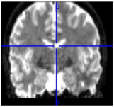
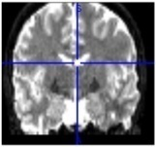
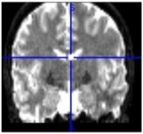

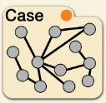
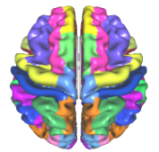

Raw data acquisition
NIdata Format
Subject ID
Phenotype list & Scan Info.
BcoBase (BCoData & Notes)
Multimodal
Imaging data &
Additional metadata
BCoData
……
e.g., Dicom, NIfTI files
Volume 1
Volume 2
Volume 3
Volume t
BCoData4D (4D data array)
Conversion & Reduction
Mask
Data Matrix
ROI Templates
Data Matrix
OR
An index vector for
voxels of interest
Voxel-wise data
within the mask
Template for ROI study
ROI-based data
or analysis results
BCoData2D
BCoData2DReduc

Slide 5
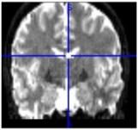
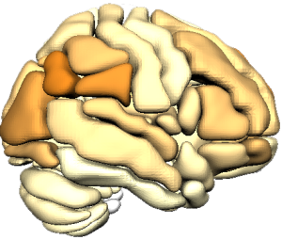
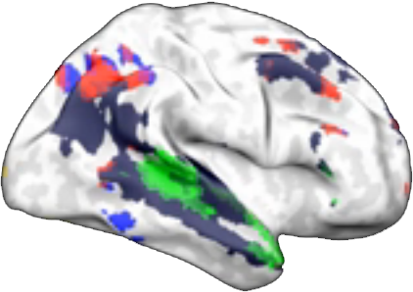
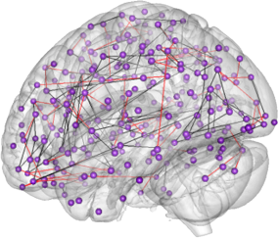
Subject ID
Phenotype list & Scan Info.
Neuroimaging Data
BCoData
……
Volume 1
Volume 2
Volume 3
Volume t
BCoData4D (4D data array)
Conversion & Reduction
Mask
2D Data Matrix
ROI Templates
2D Data Matrix
OR
An index vector for
voxels of interest
Voxel-wise data
within the mask
Template for ROI study
ROI-based data
or analysis results
BCoData2D
BCoData2DReduc
“Wildcard” Free Slot
Users can store anything in this slot, such as potential statistical analysis results.
Parcellation Analysis
Activation Analysis
Connectome Analysis
User Text Comments

